Slide 1

AMANDA (CLASS X)
Prepared By:
Anuradha Mathur

Slide 2

ABOUT THE AUTHOR
Robin Klein is a poet who takes in his pen, the everyday and universal happenings of life. Activities pertaining to small children are very dear to him as they represent, innocence, love, smartness and their nature.

Slide 3
SUMMARY OF THE POEM
The poem describes a girl named Amanda and her mother who is nagging her for her mistakes. She is first pointed out most probably by her mother for biting her nails and for not sitting in the right posture. The mother also feels that Amanda sits in a very lazy manner. To this, Amanda imagines herself as a mermaid who lives a calm and relaxing life in the beautiful green sea. Further, she is nagged for not cleaning her room and shoes and also for not doing her homework. She then imagines herself to be an orphan because she is now fed up of being watched by her parents continuously. She says that she would have enjoyed her freedom then, by making the patterns of her bare feet on the sand and would live a peaceful life. Next, Amanda is scolded for eating too many chocolates as this causes pimples. She is also scolded for not listening to her mother. So, now Amanda thinks of being Rapunzel, a character from a fairy tale and wants to live in a huge tower like her. In the tower she will be alone and will live a peaceful life and will never allow anyone to come in. Finally, the mother asks her to stop being moody because she doesn’t want anyone to blame her for harassing her daughter. At this time the poet has not written any reaction from Amanda’s side. This constant nagging has made her so sad that she has even stopped to imagine herself as someone else. She used to do so in order to escape from the continuous harassment and dominance of her parents.

Slide 4
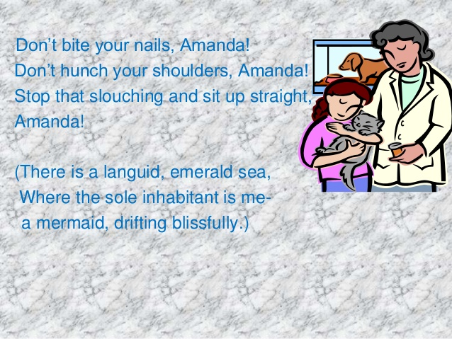
STANZA 1

Slide 5
EXPLANATION
One of the parents sees Amanda biting her nails. The parents tells Amanda not to bite her nails. She is also not to bend her shoulders and to sit up straight. The parent nags Amanda for sitting lazily with her shoulders bent into a stoop.
But Amanda is lost in her own dreams. She imagines herself to be a mermaid drifting joyfully with the soft waves of the green sea. She imagines that she is the sole inhabitant of the beautiful sea and there is no one to nag or disturb her.

Slide 6

LITERARY DEVICES
Anaphora: Repeated use of a word at start of two or more lines (don’t bite… don’t hunch)
Assonance: use of vowel sound ‘o’ (don’t hunch your shoulders) Rhyme: aaba ccc (Amanda, Amanda, straight, Amanda, sea, me, blissfully)
Metaphor: use of word emerald sea for green colour of sea being similar to the colour of emerald
Repetition: use of word ‘Amanda’
Imagery: drifting blissfully
Alliteration: ‘Stop that slouching and sit up straight’ - ‘s’ sound is being repeated at the start of closely placed words.
Allusion: ‘mermaid’ is a well-known imaginary creature.

Slide 7
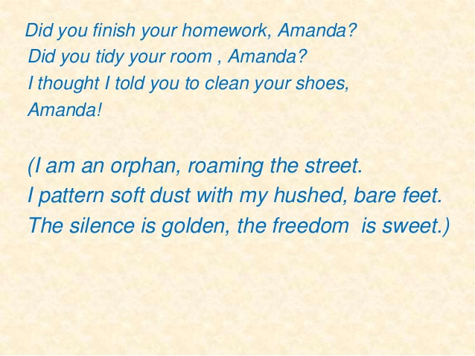
STANZA 2

Slide 8
EXPLANATION
The parent asks Amanda if she has finished her homework. She is asked if she has tidied her room. She had been asked to clean her shoes also. The parent asks her if she has done that.
But Amanda is lost in her own thoughts. She imagines herself to be an orphan with no parents to nag her. She feels happy in being an orphan. She imagines that she is roaming in the street with bare feet. She is making soft patterns as she puts her feet gently in the dust. There is all silence about her with no one to nag her. For the little girl, this silence is golden and this freedom is so sweet.

Slide 9

LITERARY DEVICES
Anaphora: Repeated use of a word at start of two or more lines (did you finish….did you tidy)
Rhyme: Rhyme scheme is aada eee (Amanda, Amanda, shoes, Amanda, street, feet, sweet)
Assonance: use of vowel sound ‘o’ (Thought, told, you, your, shoes)
Repetition: use of word ‘Amanda’
Metaphor: silence is golden - silence is said to be glorious like golden colour freedom is sweet - freedom is said to be sweet in taste.

Slide 10
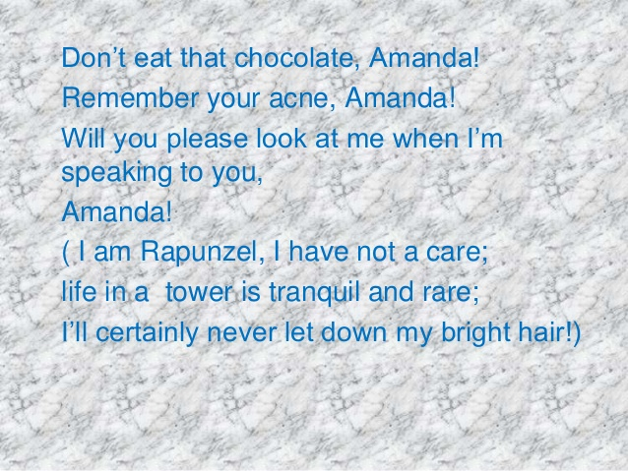
STANZA 3

Slide 11
EXPLANATION
The parent sees Amanda eating a chocolate and tells her not to eat it. The parent says that Amanda must not have forgotten the acne that she had got previously. However, Amanda is lost in her own dreams and doesn’t look up to the parent. At this the parent feels irritated. He says that Amanda should at least look at him when he is speaking to her.
But Amanda remains lost in her dreams. She imagines herself to be golden – haired Rapunzel who lived in a castle and had no care. Amanda imagines that life for Rapunzel must have been very peaceful and wonderful in the tower. However, she says that she won’t let down her bright hair the way Rapunzel had done. All the troubles of Rapunzel, as we know, had started because of her doing so.

Slide 12
LITERARY DEVICES
Allusion: use of famous fairy tale character Rapunzel
Rhyme: rhyme scheme aafa ggg (Amanda, Amanda, you, Amanda, care, rare, hair)
Assonance: use of vowel sound ‘e’ and ‘o’ (Will you please look at me when I’m speaking to you
Consonance: use of sound ‘r’ (I am Rapunzel; I have not a care …..Bright hair)
Repetition: use of word ‘Amanda’

Slide 13
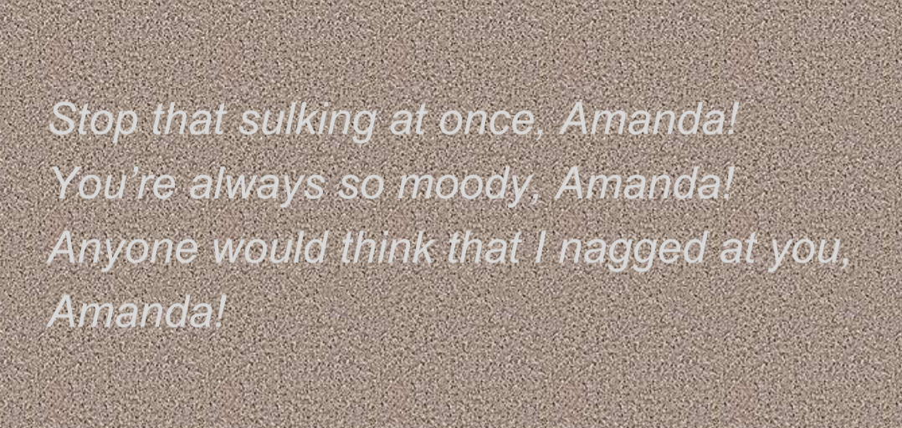
STANZA 4

Slide 14
EXPLANATION
The parent keeps talking to Amanda about the various do’s and don’ts, but Amanda remains lost in her own dreams. The parent thinks that Amanda is not responding because she is angry. He feels annoyed and asks Amanda to stop sulking at once. He says that it has become a habit with Amanda to remain irritated always. On seeing her, one would say that the parent has nagged at her and that is why Amanda is looking gloomy. The parent doesn’t want Amanda to give others such an impression.

Slide 15
LITERARY DEVICES
Alliteration: ‘Stop that sulking’ - ‘s’ sound is repeated at the start of closely placed words
Repetition: use of word ‘Amanda’
Rhyme scheme: aaha (Amanda, Amanda, you, Amanda)

Slide 16


